Slide 1
Navigation inference using smartwatch
----- feasibility study stage
Trey Zhong
Sep/28/2015

Slide 2
Methodology
Collect data
Preprocess data
Normalization
K-means clustering
Build the machine learning model
Train the model
Evaluate the model
Road mapping

Slide 3
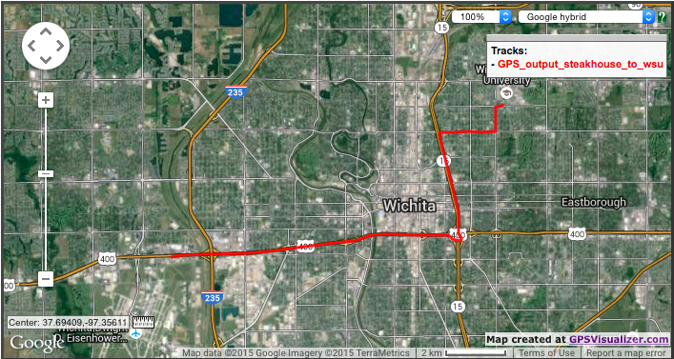
Methodology --- Collect data

Slide 4
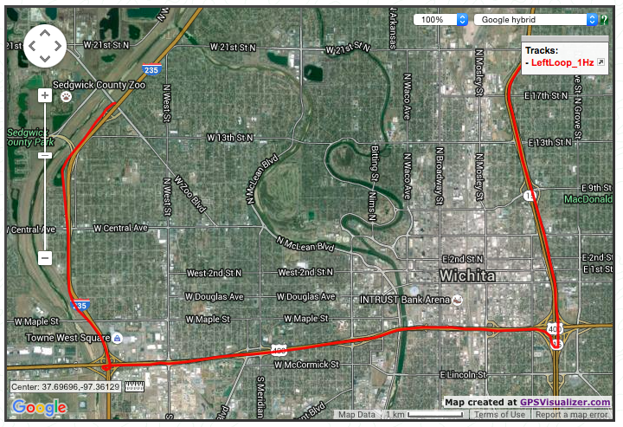
Methodology --- Collect data

Slide 5
Methodology --- Preprocess data
Redundant data is removed
Redundant data includes the data at the beginning before leaving the campus, the data while synchronize the smart watch with GPS data, and the data after leaving freeway.
Convert GPS data to displacement data

Slide 6
Methodology --- Normalization
Accelerometer: data_{normalized} = (data – min)/(max - min)
Gyroscope: data_{normalized} = (data – 180º)/360º
GPS: data_{normalized} = (data – min)/(max - min)

Slide 7
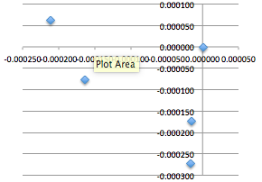
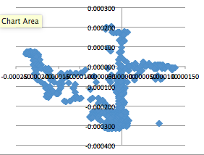
Methodology --- K-means clustering
GPS data clustering: 7 centroids
GPS data plot

Slide 8
Methodology --- K-means clustering
7 sensor data centroids if sensor includes gyroscope
12 sensor data centroids if sensor doesn’t include gyroscope

Slide 9
Methodology --- Build model
After clustering for the motion data and the displacement data
Translation model: it contains motion label and displacement label pairs and the corresponding counts/ occurrences
Trajectory model: it contains displacement label sequences and the corresponding occurrences

Slide 10

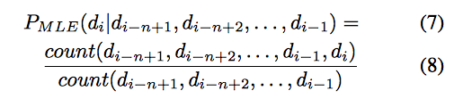
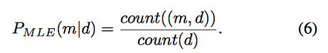
Methodology --- Train the model

Slide 11
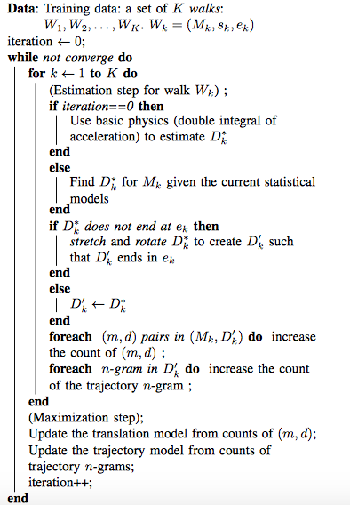
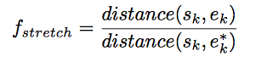
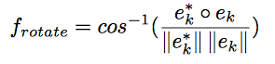
Methodology --- Train the model
s_{k} is the starting position
e_{k} is the ending position
M_{k}, D_{k} is a sequence of motion label and displacement label
Every (inner) iteration is a prediction of a sequence of n displacement labels given n motion labels.

Slide 12
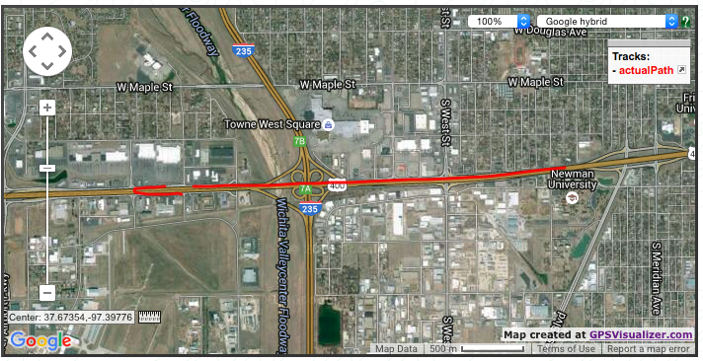
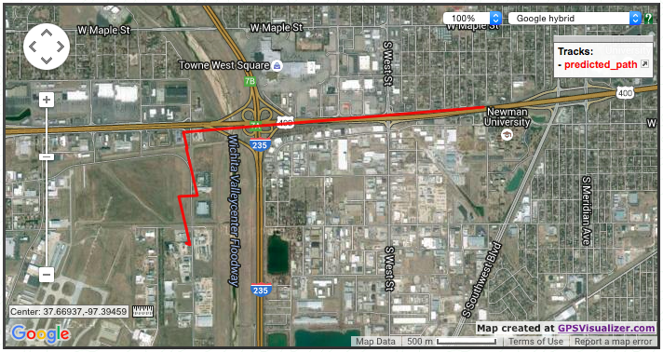
Methodology --- Evaluate the model
(with gyro sensor data)

Slide 13
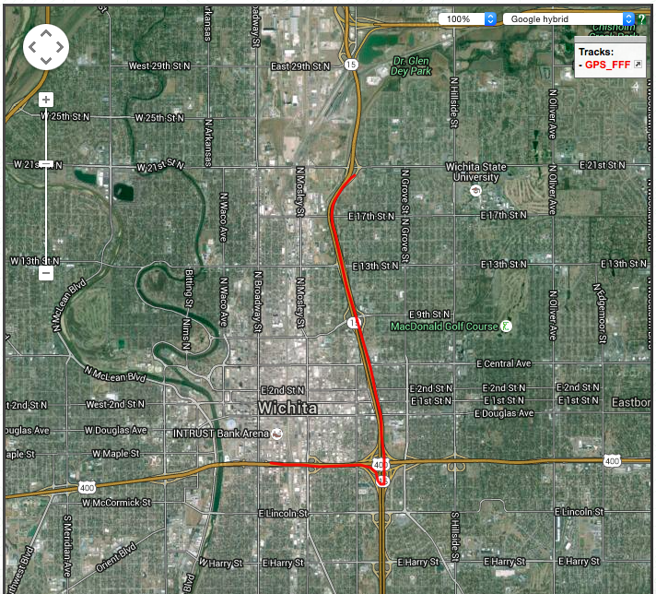
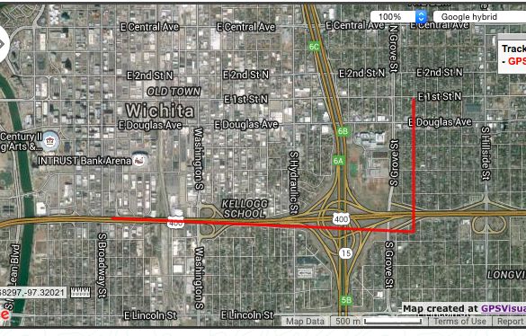
Methodology --- Evaluate the model
(without gyro sensor data)

Slide 14
Methodology --- Road mapping
We don’t have the GIS data yet

Slide 15

Conclusion
It’s feasible!!!

Slide 16
Discussion
Hand position matters
Effect of traffic and stop sign
Effect of gyro sensor data
What I have done different from the paper?
Effect of different numbers of clustering centroids
Advice on road selection

Slide 17
Discussion --- hand position
During the experiment, the driver‘s hand position is on 9 o’clock position on the steering wheel when driving straight line.
The turning involves the right hand though the right hand motion is not tracked.

Slide 18
Discussion --- traffic and stop sign
The machine learning model used for navigation prediction is highly relying on probability. Too much traffic or stopping during data collection can cause big inaccuracy in the prediction because the motion label for driving constantly speed on straight line should be the same as that on stationary position because in both case the acceleration is zero.

Slide 19
Discussion --- gyro sensor data effect
The influence of gyro sensor data is significant because azimuth angle indicates magnetic north. Therefore, when azimuth is included, the motion for straight line driving actions are differentiated from one angle to the other.
Using gyro sensor data in the motion label can help increase the accuracy in the turning cases.

Slide 20
Discussion --- what I have done differently
The original method from the paper uses the basic physics for the initial displacement prediction
But I tried in two different ways
The motion labels that uses gyro and accelerometer have enough separation. Simply EML for motion-displacement pairs will do for the initial kick off.

Slide 21
Discussion --- what I have done differently
Continue…
For the motion labels that don’t use gyro sensor data, it’s assumed that the initial n displacements are known; and the initial n displacements are the same label (e.g.: the object starts from a straight line);

Slide 22
Discussion --- what I have done differently
Continue…
I skipped the training process due to time issue
The training process fine tunes the model but we only need to see if the prediction is close enough during the feasibility study stage

Slide 23
Discussion --- what I have done differently
Continue…
I didn’t use the trajectory model (the one with displacement sequence and corresponding counts) for the prediction because the motion labels with gyro sensor data give good enough clustering that we can get good accuracy just with the translation model (the on with motion label and displacement pairs and corresponding counts)

Slide 24
Discussion --- what I have done differently
Continue…
I did use the trajectory model when gyro data is not included in the motion label.

Slide 25
Discussion --- centroids number influence
If we have too insufficient centroids number, the prediction will be inaccurate
Using gyro sensor provides extra information which allows less centroids for the motion data
Increase the number of motion cluster centroids helps differentiate the random motion and the noise when driving straight line versus the turning motion.

Slide 26
Discussion --- advice on road selection
In general, the road selected for training should includes all the scenarios that could happen in the routes for prediction/evaluation

Slide 27
Reference
http://mlt.sv.cmu.edu/joy/publications/ProbIN_MELT2010.pdf
http://www.netsec.ethz.ch/publications/papers/han_ACComplice_comsnets12.pdf
https://github.com/qizhong19920114/smartWatch_Navigation_Inference_ProbIN

Slide 28

Q&A

